Slide 1
Chapter Two: Logical algebra
Let’s have a quick start on the whiteboard.

Slide 2
Chapter 2 Logical algebra
2.1 Three basic functions of logical algebra
2.2 Laws and Rules of logical algebra
2.3 Forms and transformation of logic functions
2.4 Simplification of logic functions

Slide 3
2.1 Three basic functions of
logical algebra
and: logical multiplication
or: logical addition
not: logical inverter

Slide 4
(1) “and” function
switch
A
B
power
supply
F
E
light
Function Table
Truth Table
A B F
A B F
off off off
0 0 0
off on off
0 1 0
on off off
1 0 0
on on on
1 1 1

Slide 5
If all conditions are met, the event will occur.
It is called logical multiplication (and).
Logic function of “and”
F＝f(A，B)=A·B＝AB
Logic gate of “and” (hardware symbol)
A
F
B

Slide 6
(2) “or” function
A
switch
power
supply
E
F
B
light
Function Table
Truth Table
A B F
A B F
off off
off
0 0 0
off on
on
0 1 1
on off
on
1 0 1
on on
on
1 1 1

Slide 7
If one condition is met, the event will occur.
It is called logic addition (or).
Logic function of “or”
F＝f(A，B)＝A＋B
Logic gate of “or” (hardware symbol)
A
F
B

Slide 8
(3) “not” function
R
resistor
E
power
supply
A
F
light
switch
Function Table
Truth Table
A F
A F
off on
0 1
on off
1 0

Slide 9
The input and output are inverted.
It is called not (inverter).
Logic function of “not”
F＝A
Logic gate of “not” (hardware symbol)
A
F=A

Slide 10
2.2.1 Laws of logical algebra
2.2 Laws and Rules of logical algebra
(1) Laws of 0 and 1

Slide 11
(2) Laws of single variable
(3) Commutative Law

Slide 12
(4) Associative Law
A(BC)=(AB)C=(AC)B
A+(B+C)=(A+B)+C=(A+C)+B
(5) Distributive Law
A(B+C)=AB+AC
distributive law of multiplication
distributive law of addition
A+BC=(A+B)·(A+C)
Proof: Right of Eq.=AA+AC+AB+BC=A+AC+AB+BC
=A(1+C+B)+BC=A+BC=Left of Eq.

Slide 13
(6) De Morgan’s Laws
Proof by truth table:
0 0 0 1 1 1 1
0 1 0 1 1 0 1
1 0 0 1 0 1 1
1 1 1 0 0 0 0

Slide 14
(7) The other commonly used laws
①
④
②
⑤
③
redundancy law
appending law
There are three product terms. The first two product terms contain the inverted variables A and A NOT. The third term contains the rest variables from the first two terms. The third term is redundant.

Slide 15
①
Proof:
②
Proof:
③
A+BC=(A+B)·(A+C) distributive law of addition
Proof:

Slide 16
④
A+BC=(A+B)·(A+C) distributive law of addition
Proof:

Slide 17
⑤
Proof:
Left of Eq.=
Right of Eq.
Extension of redundancy law ⑤:
Proof:
Left of Eq.
Right of Eq.

Slide 18
2.2.2 Rules of logical algebra
(1) Substitution Rule
Replace the variable with a function. Then the new expression holds.
Example
Replace
Notes:
Replace B with DC.
Apply the De Morgan’s Laws.

Slide 19
De Morgan’s Laws
Replace B with more variables, we get the general form of De Morgan's law:
Notes:
Replace B with more variables, we get the general from of De Morgan’s law.

Slide 20
(2) Inversion Rule
(we use it to write the inverse function.)
→
0 1
1 0
+
Exchange
+
Keep the operation order.
Notes:
The inverse function is written as F NOT.
Exchange 0 and 1. Exchange plus and dot.
Exchange original variable and inverted variable.

Slide 21
Write the inverse function.
Example 1
Example 2
Example 3
Notes:
Exchange original variable and inverted variable. Exchange plus and dot.
In example 1 and example 3, add parentheses to keep the operation order.
In example 2, the big inverter is offset.

Slide 22
(3) Duality Rule
(We use it to write the dual function.)
F(A，B，C )
F^{D}(A，B，C )
→
0
1
Exchange
1
0
+
+
A and are unchanged (keep the inverter).
Keep the operation order.
Notes:
The dual function is written as F-D

Slide 23
Properties of Duality Rule
(1) If an equation is correct, its dual form must be correct.
(2) If two functions are equal, their dual forms are also equal.
(3) If we apply the duality rule on a function twice, we will obtain the original function.
(F^{D})^{D} = F

Slide 24
Example: Use Duality Rule to prove the distributive law of addition.
A+BC=(A+B)·(A+C)
Proof:
Let
F₁=A+BC F₂=(A+B)·(A+C)
Apply Duality Rule to get the dual function:
F₁^{D}=A(B+C)=AB+AC F₂^{D}=AB+AC
F₁^{D}= F₂^{D}
Then,
F₁=F₂
Notes:
Prove the distributive law of addition.
Separate the left side and right side of the formula.
Apply the duality rule(exchange dot and plus).

Slide 25
(4) Expansion Rule (we use it to simplify function.)
If we have a logic function
F=f(X₁,X₂,···X_{n})，
X₁
separate a variable, e.g., from F and expand F as follows:
Let to prove the above.
X₁=0 or X₁=1

Slide 26
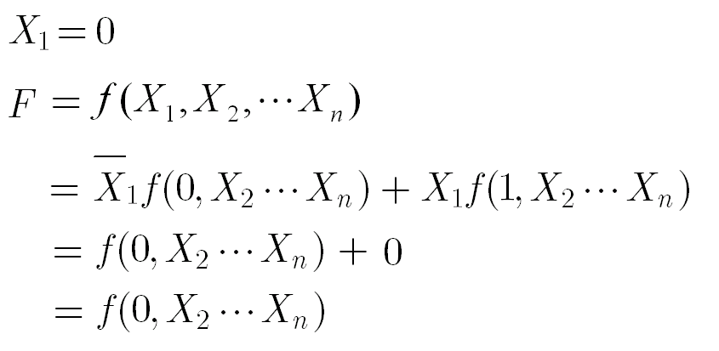

Slide 27
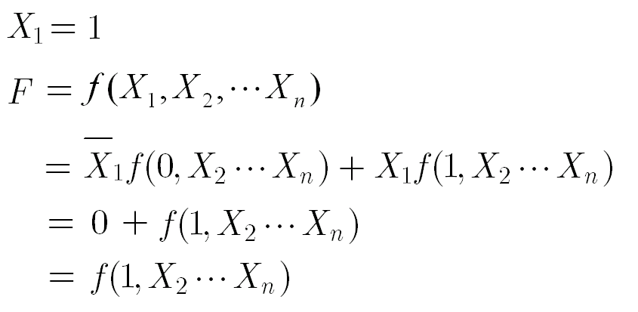

Slide 28
Example: Simplify logic function by expansion rule.
Solution: (separate variable A)
Notes:
Write A NOT dot. Replace A with 0 in the function.
Write A dot. Replace A with 1 in the function.
Variable A appears many times in function F.

Slide 29
2.2.3 Compound Functions
Logic gate
(hardware symbol)
NAND
A
F＝AB
A
F
B
B
NOR
A
A
F＝A＋B
F
B
B
Notes:
NAND gate: AND gate is followed by inverter
NOR gate: OR gate is followed by inverter

Slide 30
AND-OR-INVERTER
A
B
F=AB+CD
C
D
A
Logic gate
(hardware symbol)
F
B
C
D
Notes:
Two AND gates, followed by OR gate, then followed by inverter.

Slide 31
XOR
XNOR
exclusive or
exclusive nor
inclusive or
Logic function
Logic gate (hardware symbol)
A
A
F
F
B
B
Notes:
Operator of XOR: plus inside a circle
Operator of XNOR: dot inside a circle
XOR equals …, XNOR equals …

Slide 32
How to understand XOR?
XOR：if A，B are unequal, then F=1.
How to understand XNOR?
XNOR：if A，B are equal, then F=1.
Notes:
How to understand XOR?
How to understand XNOR?

Slide 33
Truth Table
A B A B A B
0 0 0 1
0 1 1 0
1 0 1 0
1 1 0 1
If there are two inputs, XOR and XNOR are opposite.

Slide 34
Truth Table
A B C
A B C
A B C
0 0 0 0 0
0 0 1 1 1
0 1 0 1 1
0 1 1 0 0
1 0 0 1 1
1 0 1 0 0
1 1 0 0 0
1 1 1 1 1
If there are three inputs, XOR and XNOR are equal.
Notes:
If there are three inputs,

Slide 35
Rules of XOR and XNOR
(1)
1 0=0 1=1 0 1=1 0=0
0 0=0 1 1=1
1 1=0 0 0=1
0 A=A 1 A=A
(2)
1 A=A 0 A=A
A A=0 A A=1
A A=1 A A=0
Treat A as 1. Treat A as 0.
Notes:
If the two inputs are unequal, the xor result is 1.
If the two inputs are equal, the xnor result is 1.

Slide 36
(3) Commutative Law
A B=B A A B=B A
(4) Associative Law
A (B C)=(A B) C
A (B C)=(A B) C
Notes:
Commutative Law: we can exchange positions of A and B.
Associative Law: we can combine any two variables for calculation.

Slide 37
(5) Distributive Law
A(B C)=AB AC
Right=ABAC+ABAC=AB(A+C)+AC(A+B)
=ABC+ABC=A(B C)=Left
A+(B C)=(A+B) (A+C)
Right =(A+B) (A+C)+(A+B)(A+C)=ABC+A+BC
=A+BC+BC=A+(B C)= Left
Notes:
(1)Take AB as a whole. Take AC as a whole. Apply the De Morgan’s Laws. Remove parentheses. A and A NOT are offsetting.
Extract A. Write the XOR expression.
(2) Take parentheses as a whole. Apply the De Morgan’s Laws. Write A NOT once. Apply the distributive law of addition. A offsets A NOT. Write the XNOR expression.

Slide 38
(6) Interchange Law
A B C
0 0 0
0 1 1
If A B=C , then A C=B or B C=A
1 0 1
1 1 0
A B C
0 0 1
0 1 0
If A B=C, then A C=B or B C=A
1 0 0
1 1 1
Notes:
If exchange the input and output, the formula holds.
Prove it by truth table. Exchange input and output in the truth table.

Slide 39
2.3.1 Basic Forms of Logic Functions
2.3 Forms and Transformation of Logic Functions
1.Basic AND-OR Function
e.g.
2. Basic OR-AND Function
e.g.
Notes:
Basic AND-OR function: First do the multiplication. Second, do the addition.
Basic OR-AND function: First do the addition. Second, do the multiplication.

Slide 40
2.3.2 Standard Forms of Logic Functions
1. Standard AND-OR Function
Also, Sum of Products,
Sum of Minterms
e.g.
2. Standard OR-AND Function
Also, Product of Sum,
Product of Maxterms
e.g.
Notes:
Standard AND-OR Function: is composed of minterms
Standard OR-AND Function: is composed of maxterms
These product terms are minterms.
These sum terms are maxterms.

Slide 41
What is a Standard Function?
In each term, each variable must occur only once.
The variable is in the original form (A) or the inverted form (A NOT).
Notes:
What is a standard function?

Slide 42
3. Minterm
In each product term, each variable must occur only once.
The variable is in the original form (A) or the inverted form (A NOT).
The product term is called Minterm.
If a function is composed of Minterms, it is called the standard AND-OR function.
010
Notes:
We use lowercase m to represent minterm.

Slide 43
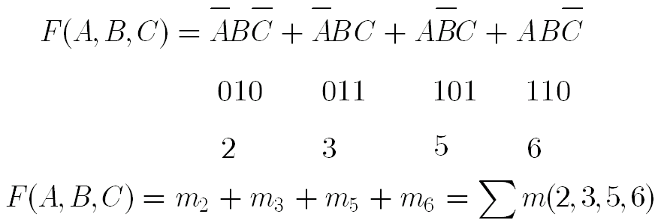
Treat A as 1.
Treat A as 0.

Slide 44
4. Maxterm
In each sum term, each variable must occur only once.
The variable is in the original form (A) or the inverted form (A NOT).
The sum term is called Maxterm.
If a function is composed of Maxterms, it is called the standard OR-AND function.
000
Notes:
We use uppercase M to represent maxterm.

Slide 45
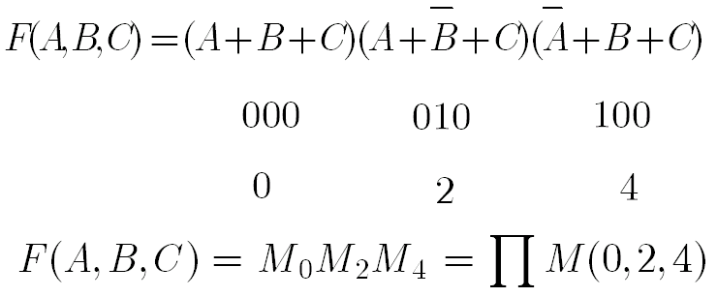
Treat A as 0.
Treat A as 1.

Slide 46
Numbered
Minterm
Numbered
Maxterm
A B C
Minterm
Maxterm
0 0 0 m₀ M₀
0 0 1 m₁ M₁
0 1 0 m₂ M₂
0 1 1 m₃ M₃
1 0 0 m₄ M₄
1 0 1 m₅ M₅
1 1 0 m₆ M₆
1 1 1 m₇ M₇

Slide 47
2.3.3 Transformation of Logic Functions
Convert the function to sum of Minterms or product of Maxterms.
1. Find the sum of Minterms of a function.
Step 1: Write the basic AND-OR function
Step 2: Apply the following formula to recover the missing variable in product terms.

Slide 48
Example of Minterms
All the Minterms of function F(A,B) with two inputs
Minterms
Binary numbers for Minterms
Numbered Minterms

Slide 49
Example of Minterms
All the Minterms of function F(A,B,C) with three inputs
Minterms
Binary numbers for Minterms
Numbered Minterms

Slide 50
Example: Find the sum of Minterms of a function.
Apply the following formula to recover the missing variable in product terms.

Slide 51
2. Find the product of Maxterms of a function.
Step 1: Write the basic OR-AND function
Step 2: Apply the following formula to recover the missing variable in sum terms.
Refer to Page 14.

Slide 52
Example of Maxterms
All the Maxterms of function F(A, B) with two inputs
Maxterms
Binary numbers for Maxterms
Numbered Maxterms

Slide 53
Example of Maxterms
All the Maxterms of function F(A, B, C) with three inputs
Maxterms
Binary numbers for Maxterms
Numbered Maxterms

Slide 54
Example: Find the product of Maxterms of a function.
Apply the following formula to recover the missing variable in sum terms.

Slide 55
Example: Convert to sum of Minterms.
Solution:
See details in the next two pages.
(1) Get the basic AND-OR function.
(2) Recover missing variables.

Slide 56
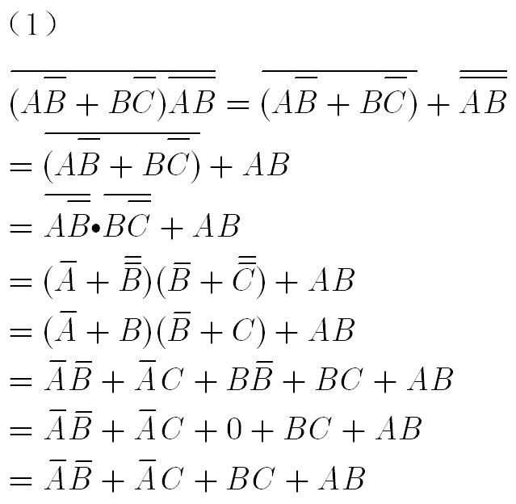
Details on function simplification

Slide 57
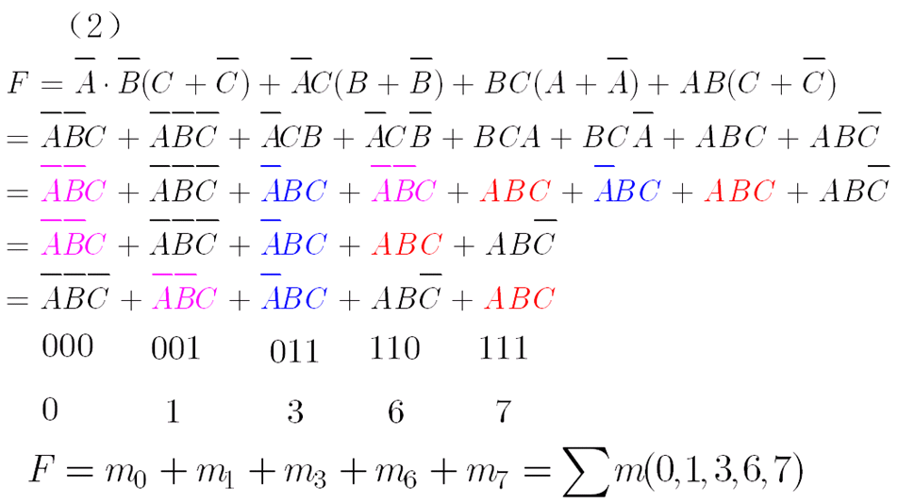
Details on recovering missing variables

Slide 58
Example: Convert to product of Maxterms.
Solution:
(1) Get the basic OR-AND function.
A+BC=(A+B)·(A+C)
distributive law of addition
Notes:
Distributive law of addition: refer to page 11.

Slide 59
A+BC=(A+B)·(A+C)
distributive law of addition
1

Slide 60
(2) Recover missing variables.
Apply the following formula
111
110
011

Slide 61
2. Function Transformation by Truth Table
Example: Covert to sum of Minterms by truth table.
A B C F
0 0 0 0
0 0 1 0
0 1 0 1
0 1 1 0
1 0 0 1
1 0 1 1
1 1 0 1
1 1 1 0

Slide 62
A B C F
0 0 0 0
0 0 1 0
0 1 0 1
0 1 1 0
1 0 0 1
1 0 1 1
1 1 0 1
1 1 1 0
Notes:
Find the lines where the outputs are 1.

Slide 63
Example: Convert the following function to product of maxterms by truth table.
A B C F
0 0 0 0
0 0 1 0
0 1 0 1
0 1 1 0
1 0 0 1
1 0 1 1
1 1 0 1
1 1 1 0

Slide 64
A B C F
0 0 0 0
0 0 1 0
0 1 0 1
0 1 1 0
1 0 0 1
1 0 1 1
1 1 0 1
1 1 1 0
Notes:
Find the lines where the outputs are 0.

Slide 65
Write sum of Minterms from Truth Table.
A B C F
0 0 0 0
0 0 1 0
0 1 0 1
m₂
0 1 1 0
1 0 0 1
m₄
1 0 1 1
m₅
1 1 0 1
m₆
1 1 1 0

Slide 66
Write product of Maxterms from Truth Table.
A B C F
0 0 0 0
M₀
0 0 1 0
M₁
0 1 0 1
0 1 1 0
M₃
1 0 0 1
1 0 1 1
1 1 0 1
1 1 1 0
M₇

Slide 67
2.4.1 Simplification by Formulas
2.4 Simplification of Logic Functions
What is the simplest function?
(1) The number of product terms is the least.
(2) The number of variables in each term is the least.

Slide 68
1. Simplification of AND-OR Functions
(1) Apply
Example 1：
(2) Apply
Example 2：
(3) Apply
Example 3：
Refer to formulas on page 14.
Notes:
Refer to page 14.
(1),(3) … is offset. … and … are offsetting. (2) Treat … as B.

Slide 69
(4) Apply the formula
Example 4：
Apply the formula
Notes:
We use auxiliary term to help simplification.

Slide 70
Example 5：
Example 6：

Slide 71
Example 7：
2. Simplification of OR-AND Functions
Example 1：
Get the dual form
Notes:
In order to get the dual function, exchange dot and plus.

Slide 72
Get the dual form again
Example 2：
Get the dual form
Get the dual form again

Slide 73
2.4.2 Simplification by K-Map
K-map is based on the Gray Code in Chapter One.
We can use K-map to simplify the logic functions.
If we draw circles on “1” blocks, we get the simplest AND-OR function.
If we draw circles on “0” blocks, we get the simplest OR-AND function.

Slide 74
1. Use K-map to represent Minterms.
F₁
B
0
1
A
0
m₀
m₁
1
m₂
m₃
K-map for the function F₁
Function F₁ has 2 input variables.
There are 4 Minterms for function F₁
00(m₀), 01(m₁), 10(m₂), 11(m₃).

Slide 75
F₁
B
0
1
A
0
m₀
m₁
1
m₂
m₃
The gray code for variable A is 0 and 1.
The gray code for variable B is 0 and 1.
A is the higher bit Variable. Put A in the vertical direction.
B is the lower bit Variable. Put B in the horizontal direction.

Slide 76
F₂
BC
00
01
11
10
A
0
m₀
m₁
m₃
m₂
1
m₄
m₅
m₇
m₆
K-map for the function F₂
Function F₂ has 3 input variables.
There are 8 Minterms for function F₂
000(m₀), …, 111(m₇).

Slide 77
F₂
BC
00
01
11
10
A
0
m₀
m₁
m₃
m₂
1
m₄
m₅
m₇
m₆
The gray code for variable A is 0 and 1.
The gray code for variables BC is 00, 01, 11, 10.
A is the highest bit Variable. Put A in the vertical direction.
BC are the lower bit Variables. Put BC in the horizontal direction.

Slide 78
F₃
CD
00
01
11
10
AB
00
m₀
m₁
m₃
m₂
01
m₄
m₅
m₇
m₆
11
m₁₂
m₁₃
m₁₅
m₁₄
10
m₈
m₉
m₁₁
m₁₀
K-map for the function F₃

Slide 79
Function F₃ has 4 input variables.
There are 16 Minterms for function F₃
0000(m₀), …, 1111(m₁₅).
The gray code for variables AB is 00, 01, 11, 10.
The gray code for variables CD is 00, 01, 11, 10.
AB are higher bit Variables. Put AB in the vertical direction.
CD are lower bit Variables. Put CD in the horizontal direction.

Slide 80
Rules for Function Simplification by K-map
(1) We draw a K-circle on 2^{n} (n=0,1,2,…) adjacent “1” blocks.
(2) Each “1” block can be circled many times.
(3) Each K-circle must contain at least one independent “1” block.
(4) 2^{n} adjacent “1” blocks must form a rectangle or a square.

Slide 81
(5) We draw as bigger K-circles as possible.
(6) The fewer K-circles are the better.
(7) We can draw a K-circle on the both ends of the K-map.
(8) For a K-circle, we write “0” as inverted variable (i.e., A NOT) and write “1” as original variable (i.e., A).
(9) We can obtain the simplest AND-OR function.

Slide 82
Hints
In the K-map, drawing circles on “1” blocks will generate the simplest AND-OR function.
In the K-map, drawing circles on “0” blocks will generate the simplest OR-AND function.

Slide 83
Draw K-circles on “1” blocks to get the simplest AND-OR function.

Slide 84
F₁
F₂
B
B
0
1
0
1
A
A
0
0
1
1
1
1
1
1
1

Slide 85
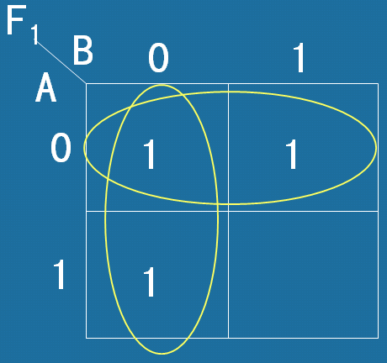
Rules for Writing Function of K-circle on “1” blocks (part 1)
Look at the vertical K-circle.
Variable A covers value 0 and 1.
Variable B covers value 0.
So variable A is offset and variable B is inverted.

Slide 86
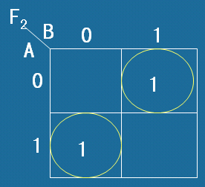
Rules for Writing Function of K-circle on “1” blocks (part 2)
Look at the left K-circle. Variable A covers value 1. Variable B covers value 0.
So we write AB.

Slide 87
Rules for Writing Function of K-circle on “1” blocks (part 3)
We write a product term for each K-circle on “1” blocks.
Connect the product terms by OR.
So we get the simplest AND-OR function.

Slide 88
Solution 1:
F₃
BC
00
01
11
10
A
0
1
1
1
1
1
1
1

Slide 89
Solution 2:
F₃
BC
00
01
11
10
A
0
1
1
1
1
1
1
1

Slide 90
F₄
BC
00
01
11
10
A
0
1
1
1
1
1
1

Slide 91
F₅
BC
00
01
11
10
A
0
1
1
1
1
1

Slide 92
F₆
BC
00
01
11
10
A
0
1
1
1
1
1
1
1

Slide 93
F₇
BC
00
01
11
10
A
0
1
1
1
1
1
1
1
1
1
F₇=1

Slide 94
F₈
CD
00
01
11
10
AB
00
1
01
1
1
1
11
1
1
1
10
1

Slide 95
F₉
CD
00
01
11
10
AB
00
1
01
1
1
1
11
1
1
1
10
1

Slide 96
F₁₀
CD
00
01
11
10
AB
00
1
1
01
1
1
11
1
1
10
1
1

Slide 97
F₁₁
CD
00
01
11
10
AB
00
1
01
1
1
11
1
1
1
10
1
1
1
1

Slide 98
F₁₂
CD
00
01
11
10
AB
00
1
1
01
1
1
11
1
1
10
1
1

Slide 99
Draw K-circles on “0” blocks to get the simplest OR-AND function.

Slide 100
F₁₃
CD
00
01
11
10
AB
00
0
0
1
0
01
1
1
1
0
11
0
1
1
1
10
0
1
0
0

Slide 101
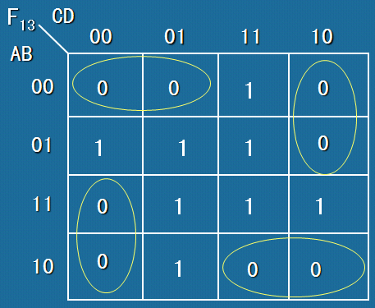
Rules for Writing Function of K-circle on “0” blocks (part 1)
Look at the horizontal K-circle on top.
Variable D covers value 0 and 1. Variable AB covers value 00, variable C covers value 0.
So variable D is offset. We write A+B+C.

Slide 102
Rules for Writing Function of K-circle on “0” blocks (part 2)
We write a sum term for each K-circle on “0” blocks.
Connect the sum terms by AND.
So we get the simplest OR-AND function.

Slide 103
F₁₄
CD
00
01
11
10
AB
00
0
1
1
0
01
1
0
0
1
11
1
0
0
1
10
0
1
1
0

Slide 104
F₁₅
CD
00
01
11
10
AB
00
0
0
0
1
01
0
0
1
1
11
0
1
1
1
10
1
1
1
1

Slide 105
Examples: Simplify Logic Function by K-Map

Slide 106
1. Write the simplest AND-OR function by K-Map.
Method One:
Find all the Minterms and put them in K-map.
Notes:
Add C plus C NOT to recover variable C.
Add B plus B NOT to recover variable B.
Remove parentheses. Write the redundant terms once.
Then, we get all the minterms. Write the numbered minterms.

Slide 107
F
BC
00
01
11
10
A
0
1
1
1
1
1
F=AC+BC+AB
Notes:
Put the minterms in the K-map.
011 for m3.
Draw K-circles. For the circle on the left, we write A C.
Finally, we get the simplified function.

Slide 108
Method Two: Recover the product terms in the K-map.
e.g.
0100
1100
1010
0111
0011
1100
1101
1011
0101
0111
F
CD
1111
1011
AB
00
01
11
10
1101
1111
00
1
01
1
1
1
11
1
1
1
10
1
1
Notes:
B C NOT D NOT, means if B is 1, C is 0, D is 0, A is 0 or 1, then F is 1.
Mark the block 0100 as 1.
Similarly, we can recover all the product terms.
Draw K-circle. For the left circle, we B C NOT.
Finally, we get the simplified function.

Slide 109
2. Write the simplest OR-AND function by K-Map.
Example: F(A,B,C,D)=∏M(3,7,11,12,13,14,15)
Can you write all the minterms for the function?
F(A,B,C,D)=∑m(0,1,2,4,5,6,8,9,10)
Numbers from 0 to 15 which are not in maxterms belongs to minterms.
Notes:
The function is composed of maxterms.
Can you write all the minterms for the function?
Numbers from 0 to 15 which are not in maxterms belongs to minterms.

Slide 110
How to write the K-map?
Method one: mark the blocks as 1 according to minterms.
F(A,B,C,D)=∑m(0,1,2,4,5,6,8,9,10)
F
CD
AB
00
01
11
10
00
1
1
0
1
01
1
0
1
1
11
0
0
0
0
10
1
1
0
1
Notes:
How to write the K-map?
Method one: mark the blocks as 1 according to minterms. Method two: mark the blocks as 0 according to maxterms.
Draw circles on‘0’blocks. Write the sum terms.
For the horizontal circle, we write A NOT plus B NOT. For the vertical circle, we write C NOT plus D NOT.
Use AND to connect the sum terms. Finally, we get the simplified OR-AND function.

Slide 111
Method two: mark the blocks as 0 according to maxterms.
F(A,B,C,D)=∏M(3,7,11,12,13,14,15)
F
CD
AB
00
01
11
10
00
1
1
0
1
01
1
0
1
1
11
0
0
0
0
10
1
1
0
1
Notes:
How to write the K-map?
Method one: mark the blocks as 1 according to minterms. Method two: mark the blocks as 0 according to maxterms.
Draw circles on‘0’blocks. Write the sum terms.
For the horizontal circle, we write A NOT plus B NOT. For the vertical circle, we write C NOT plus D NOT.
Use AND to connect the sum terms. Finally, we get the simplified OR-AND function.

Slide 112
Draw circles on‘0’blocks.
Write the sum terms.
Use AND to connect the sum terms.
F
CD
AB
00
01
11
10
00
1
1
0
1
01
1
0
1
1
11
0
0
0
0
10
1
1
0
1
Notes:
How to write the K-map?
Method one: mark the blocks as 1 according to minterms. Method two: mark the blocks as 0 according to maxterms.
Draw circles on‘0’blocks. Write the sum terms.
For the horizontal circle, we write A NOT plus B NOT. For the vertical circle, we write C NOT plus D NOT.
Use AND to connect the sum terms. Finally, we get the simplified OR-AND function.

